Slide 1
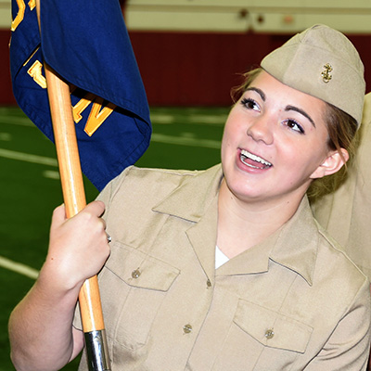

NROTC US NAVY

Slide 2
HOW TO APPLY
netfocus.ncdc.navy.mil
ACCOUNT HELP 1-800-537-4617 options 1 , 8 then 2. To Netfocus.
NLT 31 Jan 24 complete application deadline
200,000 in college tuition
First year no obligations
250-400$ per month tax free of spending money.

Slide 3
Requirements
United States citizen (either native-born or naturalized)
At least 17-years-old. Have a high school diploma or equivalent qualification
No prior convictions or drug usage
Have a 2.5 or greater high school GPA
Meet or exceed the mandated minimum SAT or ACT scores listed below:
  SAT Reading 550, Math 550 or Composite: 1000
  ACT English and Math 21 or Composite: 21

Slide 4
University in state
Naval Reserve Officers Training Corps - Navy ROTC Schools
OVER 160 colleges in the US
Michigan
University of Michigan (RN)
Cross-Town Affiliate:
- Eastern Michigan University
Ohio State University

Slide 5
Fields of study
Aviation
Surface Warfare
Submarine Warfare
Special Warfare (i.e. Navy SEAL and Explosive Ordnance Disposal)
Nursing Corps

Slide 6
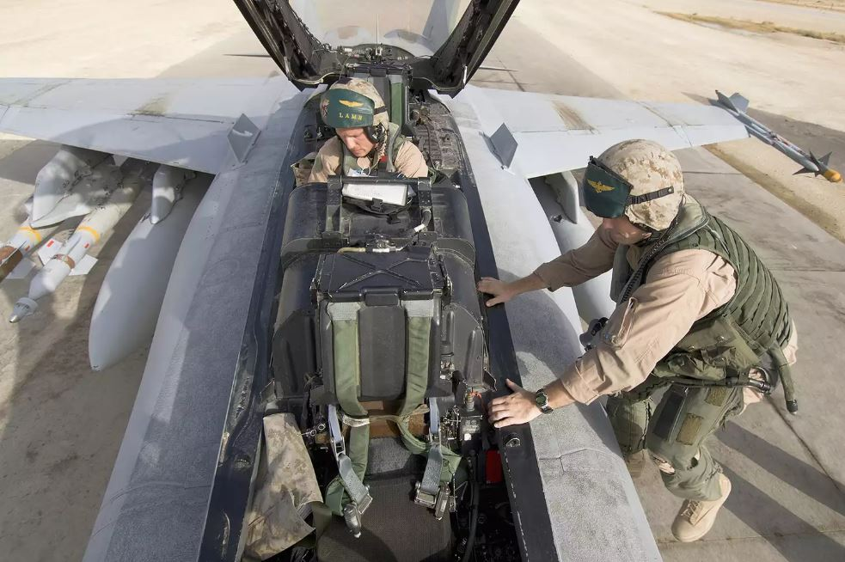
AVATION- Pilot and NFO.

Slide 7
Pilot and NFO
As a Pilot, you may:
Take part in antisubmarine warfare and mine countermeasures, as well as search and rescue operations and vertical replenishment missions
Receive specialized training on the advanced tactical systems found on Navy aircraft
Project aviation power in fighter and attack, reconnaissance, and sea control missions. launching from aircraft carriers or surface combatants.
Conduct enemy surveillance by collecting photographic intelligence
As an NFO, you may:
Study aerodynamics, aircraft engine systems, meteorology, navigation, flight planning and flight safety
Train and specialize in EA-18G Growler electronic countermeasures aircraft, E-2C Hawkeye early warning and control aircraft, or the new P-8A Poseidon antisubmarine aircraft
Electronically detect and track ships, submarines, aircraft and missiles

Slide 8

SURFACE WARFARE AKA SWO

Slide 9
SWO
Directing personnel operations aboard Navy vessels, such as aircraft carriers, cruisers, destroyers, amphibious warfare ships, mine warfare ships and frigates
Managing shipboard vertical launch systems
Using computer displays and advanced technology in battle and ship defense
Providing support to Navy expeditionary forces, Theater Air Missile operations, anti-submarine warfare, surface-to-air warfare, and support and supply missions

Slide 10
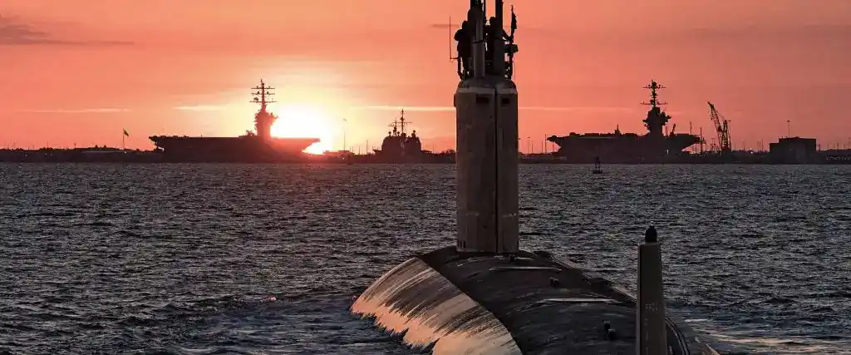
Submarine

Slide 11
Submarines
Nuclear Submarine Officers are in charge of all that goes into driving, powering, arming and operating the Navy’s Fleet of attack, ballistic missile and guided missile submarines. The stealth technology and advanced warfare capabilities of these nuclear-powered vessels, magnified by the sheer aptitude of those at the helm, has led to years of successful conflict engagement and deterrence.
The Officers who man these $1.5 billion vessels are held to the highest of standards and have extraordinary roles and responsibilities. Only a select group of disciplined and committed Officers are given the opportunity to lead departments up to an entire crew, commanding some of the most technologically advanced equipment in the world.

Slide 12

SEALS AND EOD

Slide 13
SEAL AND EOD
The Navy’s Sea, Air and Land Forces – commonly known as SEALs – are expertly trained to deliver highly specialized, intensely challenging warfare capabilities that are beyond the means of standard military forces.
Their missions include: direct action warfare; special reconnaissance; counterterrorism; and foreign internal defense. When there’s nowhere else to turn, Navy SEALs achieve the impossible through critical thinking, sheer willpower and absolute dedication to their training, their missions and their fellow Special Operations team members.

Slide 14
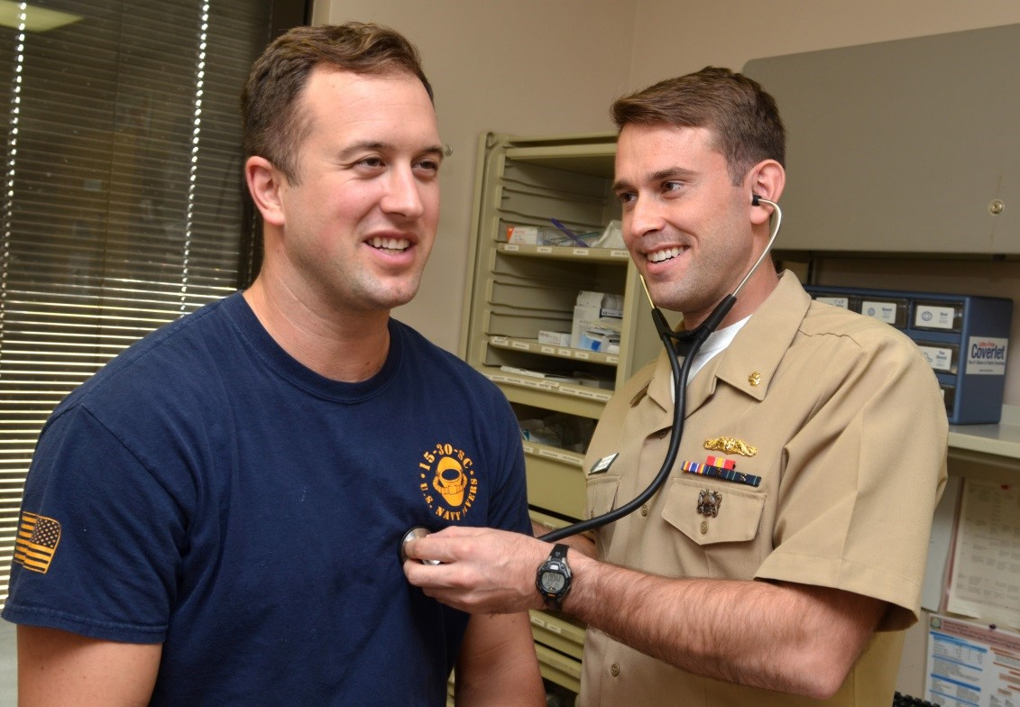
NAVY NURSE CORPS

Slide 15
NURSE
NURSING OPTION - Navy ROTC INFORMATION
Available to students interested in pursuing Bachelor of Science degree in nursing (BSN)
Available only at a university that has an Navy ROTC affiliation and offers a state approved or National League of Nursing (NLN) approved bachelor's degree in nursing.
If selected for scholarship, selectee must major in a nursing degree program leading to BSN
On graduation, Nurse Option midshipmen commissioned as regular officers in Navy Nurse Corps
While in program, male and female students participate in Navy ROTC and are referred to as midshipmen

Slide 16
QUESTIONS ?

