Slide 1
The SAT April 9th, 2019

Slide 2
Sections of the SAT
Math
Reading and Writing
Essay

Slide 4
Reading and Writing
Two tests
No more sentence completions: focus on multiple-meaning words
Passages will draw from significant historical or scientific documents-may include informational graphics, such as charts
The reading passages will include complex structure and vocabulary
Passage-based grammar-including punctuation

Slide 5
Math
Two sections: no calculator and with a calculator
Focuses on:
Application-based, multi-step questions
Higher-level math, including trigonometry
One set of “extended-thinking” grid-in questions (worth 4 points)
Core math competencies (translating English into math and math into English
A deep understanding of the theories behind mathematical principles, such as building equations

Slide 6
Essay
50 minutes, timed
Students will be provided a substantial passage (600-700 words) and will then be asked to analyze how the author built their arguments; students will need to understand the techniques authors used to write persuasively

Slide 7
Timing on the SAT
 | Time Allotted (minutes) | Number of Questions
Reading | 65 | 52
Writing and Language | 35 | 44
Math | 80 | 58
Total | 180 | 154
Essay | 50 | 1

Slide 8
Test Day Rules
Must be in Testing Room by 8 a.m- Late attendants will not be admitted
Make up testing for SAT is Tuesday, April 23rd (cannot leave early that day)
We will provide water and snack during breaks
Once testing is completed and you are dismissed by your testing proctor, students are to leave the grounds immediately. You are excused for the rest of the day
Bring these items: School ID, 2 #2 pencils, calculator
Leave these items in your locker: PHONES, APPLE WATCHES, FOOD, AND DRINKS. YOU WILL NOT BE ADMITTED IF YOU HAVE ANY OF THESE ITEMS

Slide 9
Understanding Scores
*The SAT score range is between 400 and 1600 for your total score, and 200-800 for each of your two subscores. One subscore is for Math, and one subscore is your combined Reading and Writing scores to make one “Evidence-Based Reading and Writing” score.
As you would expect, the higher your score, the better you did compared to all the other test-takers. But is there a certain SAT score cutoff that marks a “good” score?
*To determine what makes for good SAT scores relative to everyone else, it’s important to understand how SAT scoring works. Your total score out of 1600 (as well as your two sections subscores out of 800) corresponds to a percentile ranking. Your percentile tells you what percent of students you scored better than. So if you got a 60th-percentile score, you’ve scored better than 60% of all test-takers!
*The 50th-percentile SAT composite score—the average SAT score—is 1080. (The test is deliberately designed so that the average score hovers around 1000 on the 1600-point scale—about 500 per subsection). The average score for math is between 530 and 540 (530 is 49th-percentile and 540 is the 53rd). The average SAT score for Evidence-Based Reading and Writing is between 540 (49th percentile) and 550 (52nd percentile).

Slide 11
Scores
Students will receive FOUR free score report sent to the college of your choice
We will be completing this as part of the Pre-Administration section
After the test, to send official scores you will have to complete it through your Collegeboard account

Slide 12
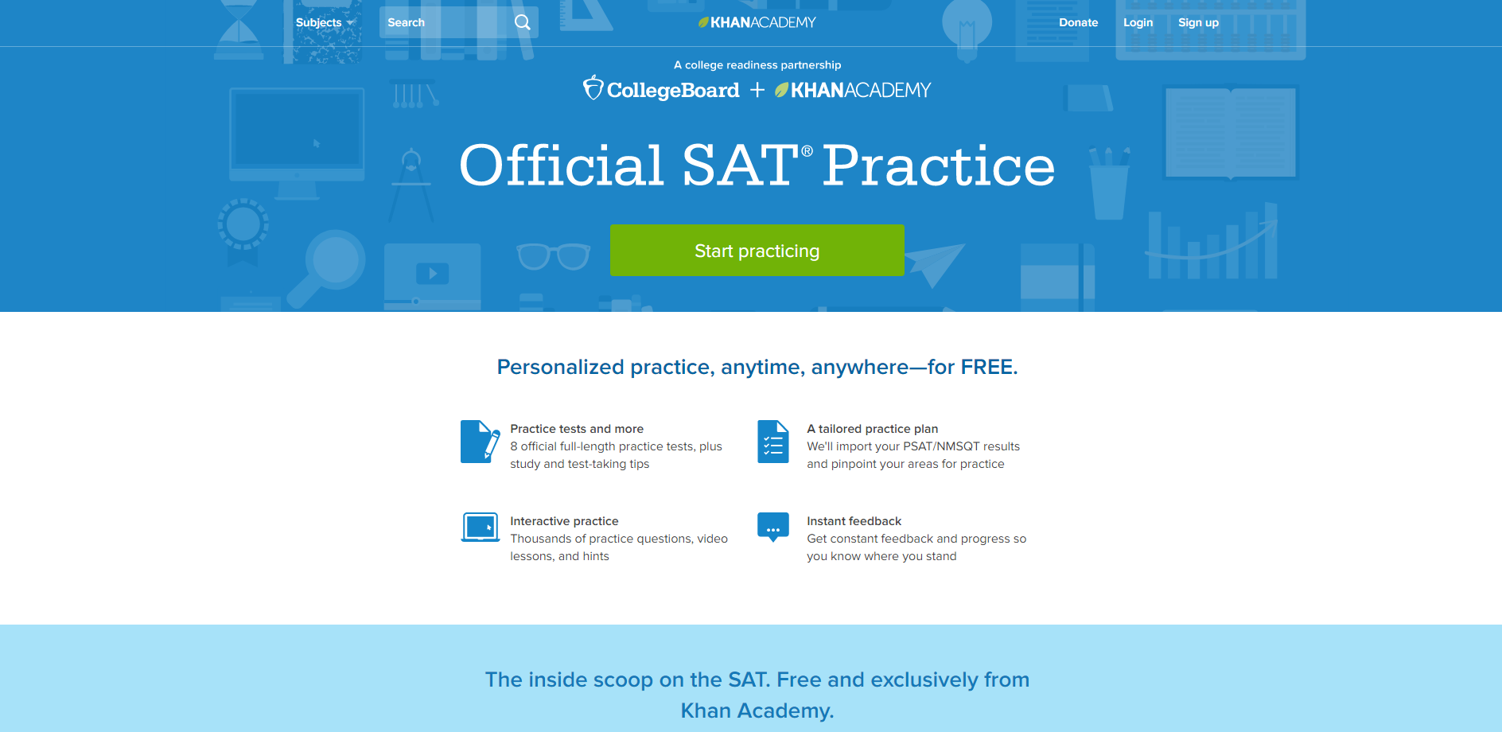
Practice Tips
satpractice.org

Slide 13
Creating Kahn Academy and College Board Accounts
Create your Kahn Academy account and then follow instructions to create a collegeboard.org account
Make sure to use A PERSONAL EMAIL, for both accounts, as your school one will expire after graduation.

Slide 14
Where do I go from here?

